Slide 1
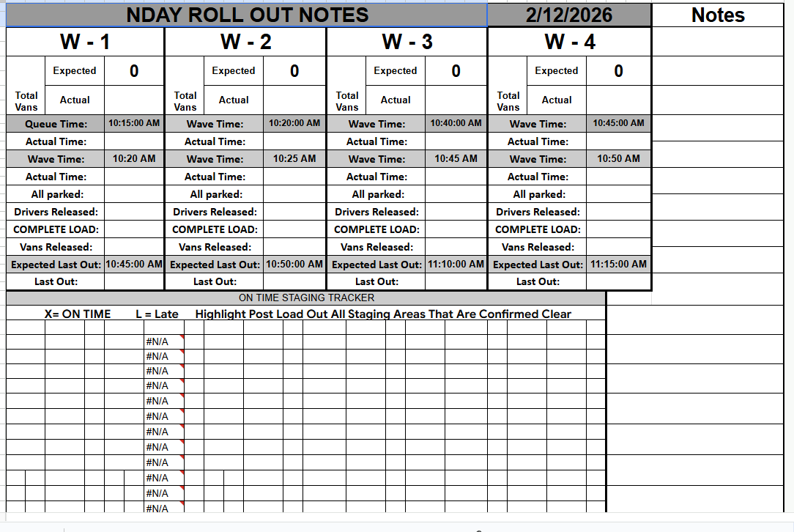
Expected count of routes that are in the individual waves.
DOP Wavetime minus 5 minutes.
DOP Wavetime
DOP Wavetime plus 25 minutes

